Slide 1


Bike Shared Systems
Regis University - MSDS696 - Data Science Practicum II
Drew Brinda

Slide 2
Contents
Problem Statement
Research Question
Dataset
Methodology
Results
Conclusions

Slide 3
Problem Statement
Bike Sharing Systems have been a growing way of easy and reliable transportation across many cities in the world. Companies need to be able to know how many bicycles should be available at each specific location in a particular city depending on time, season, weather, temperature and other factors.

Slide 4
Research Question
Can various machine learning prediction models based upon historical usage patterns with weather data help make Bike Sharing Systems more efficient within the city of Washington DC specifically by determining when bicycles should be placed at each bike docking location?

Slide 5
Dataset
The dataset used: https://www.kaggle.com/competitions/bike-sharing-demand/data
There is both a train and test csv dataset that will be used to create prediction models from. The datasets are historical hourly rental data spanning two years of worldwide bike rental systems. The training set is comprised of 19 days of each month while the testing set is the 20th day until the end of the month. Each dataset contains the fields datetime, season, holiday, working day, weather, temp, humidity, wind speed, registered users, unregister users, and count of total renters. All these factors will be considered when predicting the number of bike renters at a specific time.

Slide 6

Methodology
The project will use the train and test datasets within Python to predict the number of bike renters at a specific time and location. First, EDA on the datasets will be conducted to see likely trends on different periods of time. After, do data pre-processing and splitting into training/testing sets within Python. Next, build a few different machine learning models and test which model is performing the most accurate.

Slide 7
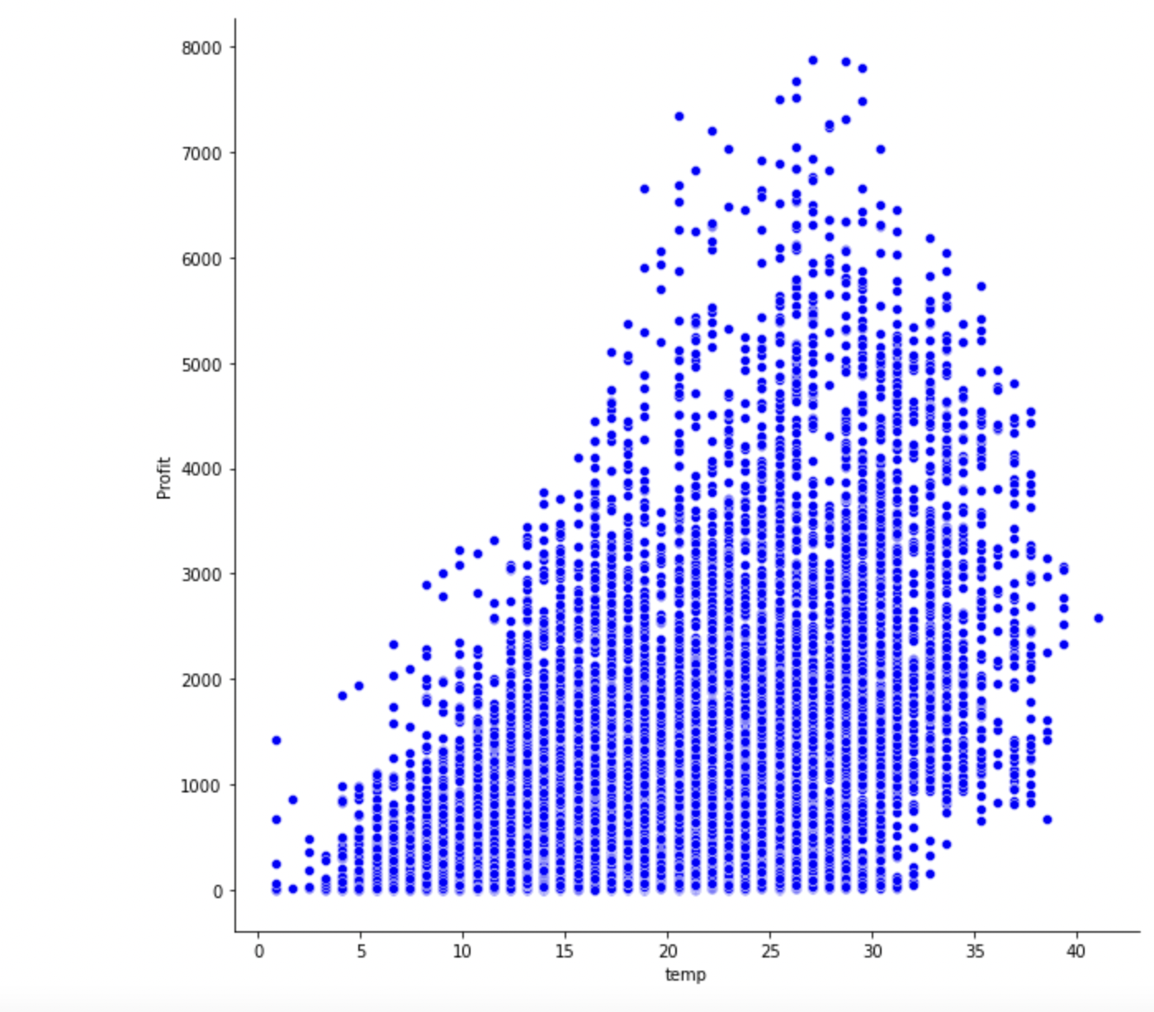
Temp by Profit

Slide 8
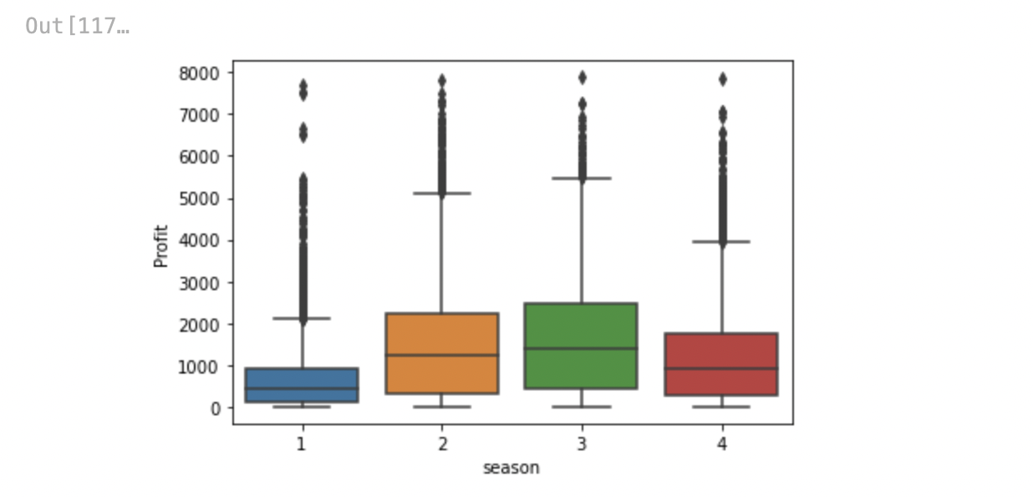
Season by Profit

Slide 9
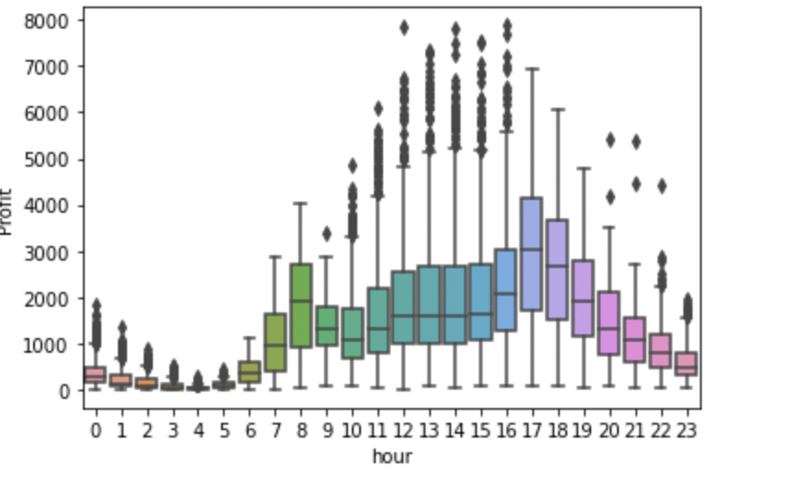
Profit by Hour

Slide 10
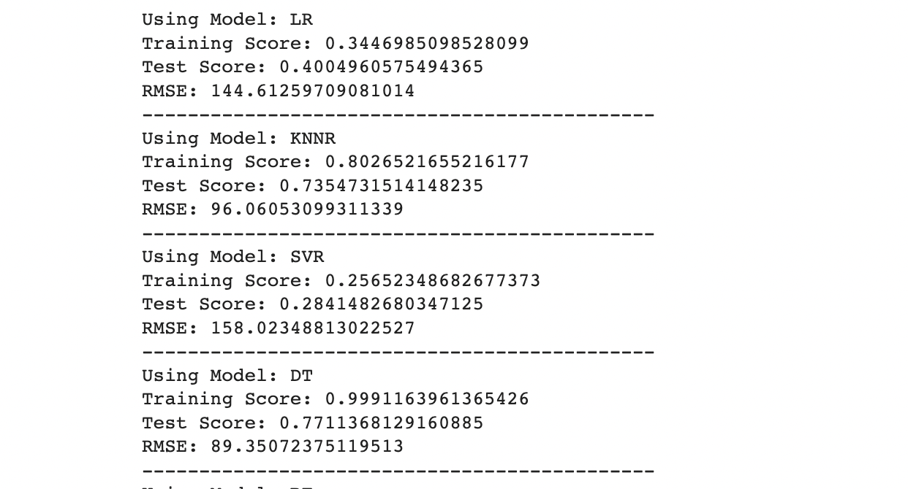
Machine Learning Models

Slide 11
Conclusions
See the trends within the data at the EDA stage of the project
Built the machine learning models to train and test to see the most accurate.

Slide 12
References
Bike sharing demand. Kaggle. (n.d.). Retrieved December 11, 2022, from https://www.kaggle.com/competitions/bike-sharing-demand/data?select=test.csv

